Slide 1
Problem Statement
What opportunities does Big Mountain Resort have for changing its ticket prices to
increase its revenues by at least $1,540,000 during the next winter season while
remaining competitive with other resorts in the market?
1
Context
The Big Mountain Resort, a ski resort in Montana, has recently installed an additional chair lift that will incur another $1,5400,000 in operation costs over the next season. Their pricing strategy has been to charge a premium based on the average ticket prices of the market; however, the resort’s management wishes to incorporate a strategy driven by a more complete understanding of the market.
2
Objectives
Identify an optimal and competitive ticket price, and calculate the resulting revenue increase if applicable
Evaluate viability of four strategies for cutting costs or increasing revenue
Report on these findings and provide recommendations at the next leadership meeting
3
Project Scope
Examine features of 300 resorts across the United States from prior ski season
Build model to ticket price based on those features
Evaluate four proposed strategies based on assumption of 350,000 customers purchasing average of 5 tickets each

Slide 2
Problem Statement continued
What opportunities does Big Mountain Resort have for changing its ticket prices to
increase its revenues by at least $1,540,000 during the next winter season while
remaining competitive with other resorts in the market?
4
Constraints and Limitations
Cannot account for ticket sales for other resorts due to lack of access to proprietary data
Cannot account for operating costs of other resort
Cannot directly account for changes in customer or ticket volume in relation to ticket price
5
Key Stakeholders
Jimmy Blackburn - Director of Operations
Alesha Eisen - Database Manager
6
Key Data Sources
US Ski Resort Market Data - Big Mountain Database
-Ticket Prices
-Resort features (lifts, tracks, sizes, etc.)
-Resort location
-Operation times ( night, season length, etc)
US State size and population data - US Census Data

Slide 3
Recommendations and Key Findings
Big Mountain Resort can increase ticket prices by at least $4
This would increase revenue by at least $7 million
Further increases should be introduced and tested gradually
The resort can close its least-used run without any expected decrease in revenue
Subsequent run closures can be expected to cost millions
Any run closures should be tested incrementally
Adding another chair lift to increase the resort’s maximum run descent by 150 ft. can support a $1.99 ticket price increase
This would increase revenue by $3.4 million
Further increases to run length are not expected to yield benefit
Further increases to snow-making coverage are not expected to yield benefit

Slide 4
Methodology 1 - Model Comparison
Model Question: Based on what we know about a resort, what would that resort be expected to charge?
Four most important features:
Number of fast four-person chairs
Number of runs
Number of snow making acres
Vertical distance from the summit to the base
Model | Simple Average | Linear Regression | Random Forest
Error (MAE) | $19.14 | $10.50 | $9.54

Slide 5
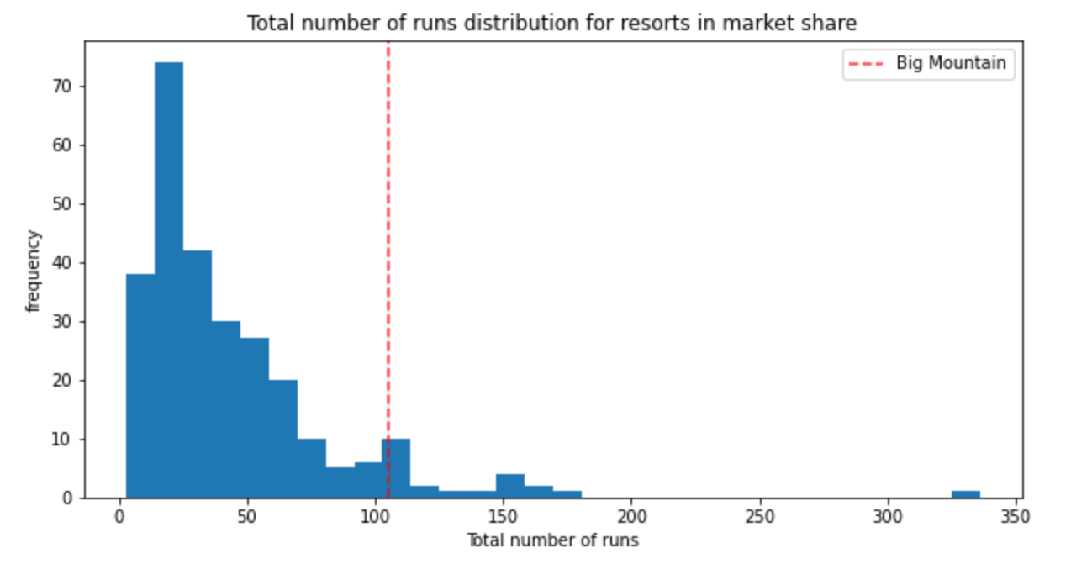
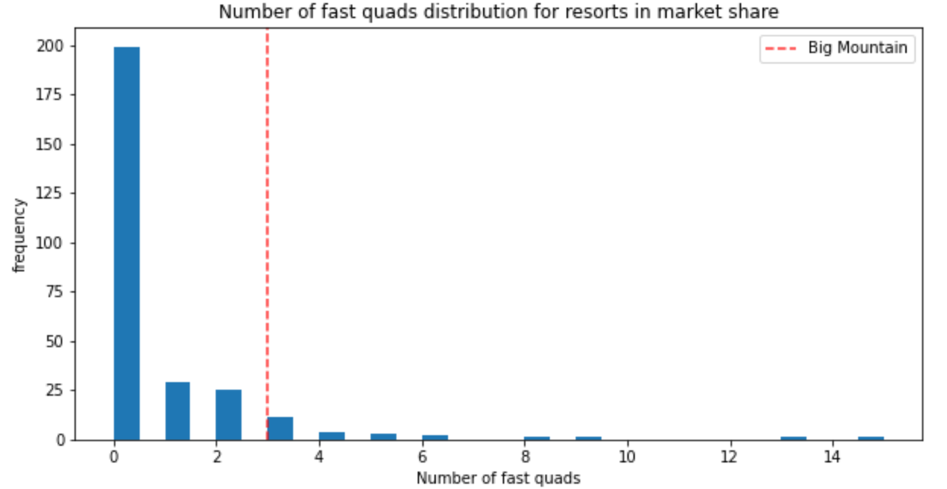
Methodology 2 - Model Output
Modelled Big Mountain Resort ticket price increase: between $4.48 and $25.26!
Potential Problems:
Are other resorts setting their ticket prices too high or low?
How many tickets are other resorts selling per season?
What overhead costs are other resorts paying?
However, Big Mountain Resort lives up to its name compared to other resorts, so it probably can increase its ticket prices!

Slide 6
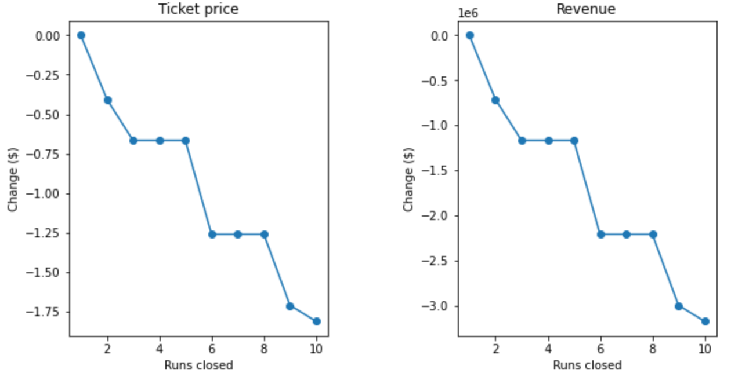
Methodology 3 - Modeled Scenarios
Scenario 1: Closing up to 10 of the least-used runs.
Assuming 350,000 customers buying an average of 5 tickets each:
The first run can be safely closed. Subsequent closures incur heavy revenue losses.
Scenario 2: Adding a chair lift to increase the longest run by 150ft:
Ticket price increase of $1.99, revenue increase > $3.4 million!
Scenarios 3 and 4: Increasing snow-making coverage and/or run length
No ticket price increase over Scenario 2

Slide 7
Summary and Conclusion
Big Mountain Resort is in a strong position to increase its ticket price! However, we recommend caution due to the absence of key information
At least one run can be closed without any predicted loss in revenue; subsequent run closures depend on potential revenue loss in comparison to reduced operating costs
Big Mountain Resort will likely benefit from the plan to install an additional chair lift; however, snow-making coverage beyond that plan suffers from rapidly diminishing returns and is not recommended

